Slide 1
Interactive Data Exploration with Smart Drill-Down
Manas Joglekar
Hector Garcia-Molina
Aditya Parameswaran

Slide 2
Overview
Problem Setting and Motivation
Algorithm
System Architecture
Experiments

Slide 3
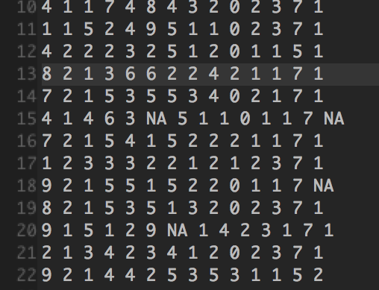
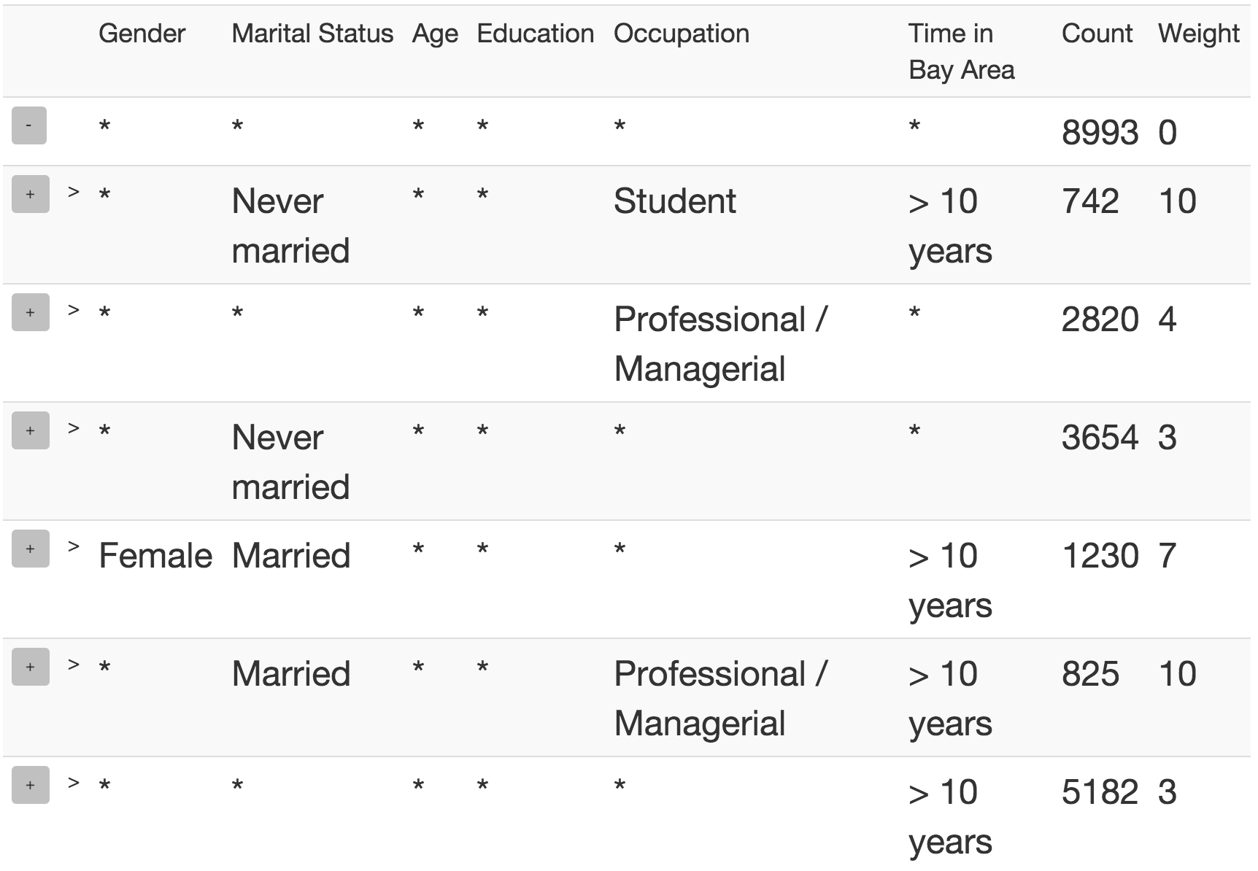
Summarizing a Table
Most interesting frequent `patterns’

Slide 4
OLAP Drill-Down
Explore relational Databases
Drill Down/ Roll Up
$10 Billion market
Limitations
Too many values
Single column

Slide 5
Smart Drill-Down
Present k most interesting patterns
Find interesting portions faster
Interactive
Instantiate multiple columns
User tunable
Complementary functionality!

Slide 6
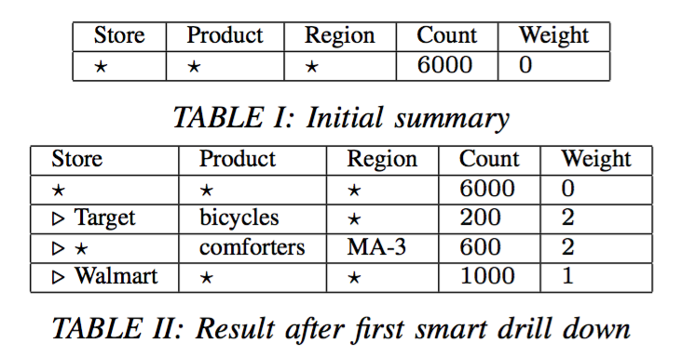
Example

Slide 7
Example

Slide 8
Definitions
Rule: Tuple of values and *’s
Rule-List: Ordered list of rules
Count: Number of tuples satisfying rule
MCount: In a list, number of tuples not covered before

Slide 9
Definitions (cont’d)
Subrule: Strictly more specific rule
e.g. (a,b,*) is a subrule of (a,*,*)
Weight: User-defined interestingess measure
Rule-List: Ordered list of rules
Score:

Slide 10
Formal Problem
Problem 1: Given a table T , a monotonic weighting function W, and a number k, find the list R of k rules that maximizes

Slide 11
Weight functions
Must be non-negative, monotone
Examples
Size : Number of non-star values
Bits : Number of bits needed to specify non-star values
Bits favors columns with more distinct values

Slide 12
Overview
Problem Setting and Motivation
Algorithm
System Architecture
Experiments

Slide 13
High level Algorithm
Theorem: Let R, R’ be rule-lists with same set of rules, where rules in R are sorted by weight (decreasing). Then

Slide 14
High level Algorithm
Theorem: Let R, R’ be rule-lists with same set of rules, where rules in R are sorted by weight (decreasing). Then
Thus, always sort rules by weight!
Find best set rather than list.
Still NP-Hard

Slide 15
Submodularity
Define
where S is rule-set, R is weight-sorted rule-list
Then Score is submodular

Slide 16
Submodularity
Define
where S is rule-set, R is weight-sorted rule-list
Then Score is submodular
Theorem: The greedy algorithm achieves a
approximation

Slide 17
High level Algorithm

Slide 18
Finding the best marginal rule
Brute-force: Compute marginal value for all rules?
Too expensive

Slide 19
Finding the best marginal rule
Brute-force: Compute marginal value for all rules?
Too expensive
Key Insight
If R₂ is sub-rule of R₁,

Slide 20
Finding the best marginal rule
Brute-force: Compute marginal value for all rules?
Too expensive
Max Weight Parameter m_{w}
A Priori-like algorithm
Evaluate all size 1, then 2, and so on
Only evaluate higher size rules that have a chance of being the best

Slide 21
Overview
Problem Setting and Motivation
Algorithm
System Architecture
Experiments

Slide 22
Scaling to large datasets
Run-time linear in table size
Doesn’t scale to millions of tuples
Slow if tuples not in main memory

Slide 23
Scaling to large datasets
Run-time linear in table size
Doesn’t scale to millions of tuples
Slow if tuples not in main memory
Solution: Sampling!
Predict clicks and maintain samples

Slide 24
Scaling to large datasets
Sample Handler:
Predicts clicks and maintain samples
Subject to two user specified constraints
minSS : Minimum sample size to compute rule-list
M : Available memory

Slide 25
Scaling to large datasets
Sample Handler:
Predicts clicks and maintain samples
Subject to two user specified constraints
minSS : Minimum sample size to compute rule-list
M : Available memory
Optimal sample allocation: NP-Hard
DP approximation

Slide 26
System Architecture

Slide 27
Overview
Problem Setting and Motivation
Algorithm
System Architecture
Experiments

Slide 28
Experiments
Datasets
Marketing Survey
Census
Studies
Qualitative
Quantitative

Slide 29
Size weighting

Slide 30
Bits weighting

Slide 31
Running time vs. mw

Slide 32
Running time vs. minSS

Slide 33
Count error vs. minSS

Slide 34
Rule error vs. minSS

Slide 35
Conclusion
Smart Drill-Down augments and generalizes regular Drill-Down
Helps find interesting portions of a table fast
Interactive
Tunable
Fast with no preprocessing

Slide 36
Thank You!!
Questions?

